Slide 1


Capture Dimensions in a Snap!
Venture Name : Debugger's KIET

Slide 2

Problem Statement Canva
Context The Mahatma Gandhi National Rural Employment Guarantee Scheme (NREGS) aims to provide 100 days of wage employment annually to rural households. However, manual documentation methods lead to inaccuracies in project monitoring and auditing. Our solution leverages technology to create 3D models, enabling real-time updates and transparent documentation, thus improving efficiency and accountability in NREGS projects | Problem Current practices in the execution of Mahatma Gandhi NREGS projects rely on manual documentation methods, resulting in inaccuracies and inefficiencies in project monitoring and auditing. This leads to challenges during audits and inspections, hindering transparency and precision in assessing work progress. | Alternatives Existing alternatives to address the challenges in NREGS project execution include improving manual documentation processes, implementing basic digital tools for data collection, or relying on external consultants for project monitoring.
Customers Key customers include government agencies responsible for implementing NREGS projects, contractors involved in project execution, engineers and technical personnel overseeing worksites, and rural households benefiting from NREGS employment opportunities. | Emotional Impact The current challenges in Mahatma Gandhi NREGS project execution not only result in inefficiencies and inaccuracies but also create frustration and disillusionment among stakeholders. Government agencies may feel overwhelmed by manual documentation processes, while contractors and engineers may experience stress due to the lack of transparency and accountability. | Alternative Shortcomings Alternatives like improving manual documentation processes often lack real-time updates, precision, and scalability, resulting in continued inefficiencies and inaccuracies in project management."

Slide 3
Problem Definition
Inadequate Documentation: Current practices in rural employment projects under schemes like MGNREGS suffer from a lack of accurate and comprehensive documentation.
Reliance on Outdated Methods: The dependence on traditional manual measurements, photographs, and paper-based records leads to inefficiencies and errors.
Audit Challenges: Difficulty in accurately assessing and verifying work done during audits and inspections due to incomplete or inaccurate data.
Delayed Wage Payments: Inefficiencies in project documentation and verification contribute to delays in processing wage payments to workers.
Transparency Issues: Lack of a comprehensive and transparent record-keeping system hinders accountability and transparency in project management.
Limited Access to Real-Time Data: Stakeholders lack access to real-time updates, impacting decision-making and resource allocation.

Slide 4

Idea Approach/Benifts
Approach:
Innovative Technology Integration: Combining photogrammetry, real-time data capture, and cloud-based storage for comprehensive 3D profiling and monitoring.
User-Centric Design: Intuitive interface for government agencies, contractors, engineers, and rural households.
Scalability: Modular design and scalable infrastructure for seamless expansion to varying project sizes.
Benefits:
Enhanced Accuracy: Detailed 3D representations for precise progress assessment.
Real-time Monitoring: Timely updates enable proactive decision-making.
Transparency and Accountability: Transparent documentation fosters trust and minimizes disputes.
Efficiency and Cost Savings: Streamlined processes lead to savings and better resource utilization.
Empowerment: Rural communities benefit from technology-driven tools for active participation.

Slide 5
TAM > SAM > SOM
15.7 trillion
1. TAM (Total Addressable Market):
The global construction industry is expected to reach a market value of over $15.7 trillion USD by 2023 (source:Future building: How 3D printing is paving new avenues in construction - Hindustan Times)
2. SAM (Serviceable Addressable Market):
Construction companies in India undertaking large-scale infrastructure projects (budgets exceeding ₹ 50 crore) and land development projects (budgets exceeding ₹ 25 crore), located in states with supportive drone regulations.
Highways, railways, airports, dams, etc. require accurate 3D models for planning, earthwork calculations, and progress monitoring. (Reference: * "India Infrastructure Report 2020" by McKinsey & Company (https://www.mckinsey.com/~/media/mckinsey/dotcom/client_service/infrastructure/pdfs/01%20building%20india.ashx) highlights the growing need for infrastructure development in India, with specific project types mentioned)
"India Real Estate Report 2023" by CBRE (https://www.cbre.co.in/insights)
3. SOM (Serviceable Obtainable Market):
Construction companies in Maharashtra undertaking infrastructure projects exceeding ₹ 100 crore, with a proven track record of adopting new technologies for project management.
Market Size: The Indian construction industry is valued at approximately $639 billion, with a projected growth rate of over 6%1. Construction Industry in India - Market Size & Growth (mordorintelligence.com)
1000 projects
25 projects

Slide 6
Customer Persona
Customer Persona: Anjali Rao
Demographics:
Age: 37
Location: Rural Andhra Pradesh, India
Occupation: Government Project Coordinator
Professional Needs:
Improve efficiency and transparency in managing rural employment projects.
Reduce delays in project documentation and wage payments.
Enhance accuracy in work assessment and reporting.
Challenges:
Manual and time-consuming documentation processes.
Inaccurate data leading to delays in audits and approvals.
Limited access to advanced technology in rural settings.
Goals:
Streamline project management processes.
Ensure timely and accurate project documentation and worker payments.
Tech Usage:
Basic digital literacy, familiar with government software for reporting.
Needs simple, robust tech solutions that work in low-connectivity areas.

Slide 7
Unique Value Proposition Slides
We're excited to present our solution, which offers a comprehensive approach to project management in rural development. Here's why our solution stands out:
Automated Documentation: Eliminates manual errors.
Real-Time Updates: Facilitates swift decision-making.
Transparency: Verifiable actions for accountability.
Advanced Tech: Photogrammetry and cloud for accuracy and security.
Efficiency: Speeds up audits and payments.
Ease of Use: Designed for all users, regardless of tech skill.
Innovation: Custom-built for rural challenges, no heavy machinery needed.
Visual Icons: Symbols for quick understanding of features.

Slide 8
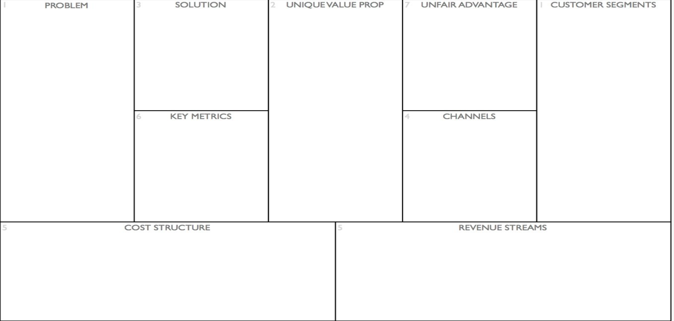
Lean Canva
The challenges faced due to the improper execution of Mahatma Gandhi NREGS project
Detailed 3D modeling for worksite assessment.
Real-time monitoring and insights.
Transparent cloud-based documentation.
User-friendly interface for all stakeholders.
Precise 3D profiling for accurate project assessment.
Real-time monitoring for proactive decision-making.
Transparent documentation for accountability.
Intuitive interface for ease of use.
Scalable infrastructure for flexibility and growth.
3D modeling is very new in India
Everything is done on paper, technology is not rooted in construction business yet.
That is why this market is empty
1. Government agencies overseeing NREGS.
2. Contractors executing NREGS projects.
3. Engineers and technical personnel.
4. Rural households benefiting from NREGS.
5. NGOs and community organizations supporting rural development.
Project Completion Time: Measure time efficiency in project execution.
Accuracy of 3D Models: Assess precision in worksite profiling.
Cost Savings: Evaluate efficiency gains and resource utilization.
1. Digital marketing for widespread outreach.
2. Partnerships with industry associations.
3. Government channels for official adoption.
4. Online platforms for community engagement.
1. Development and maintenance of technology.
2. Personnel for customer support and operations.
3. Marketing and promotional activities.
4. Infrastructure and cloud storage.
5. Training and education initiatives.
1. Subscription fees for access to the platform.
2. Licensing agreements with government agencies.
3. Value-added services such as training and customization.
4. Revenue sharing models with contractors.
5. Advertising and sponsorship opportunities.

Slide 9
Competition Analysis
Market Strategy Highlights:
Drone Mapping: Topographic aerial surveys.
IoT Sensors: Monitor earthwork in real-time.
Machine Learning: Predict project outcomes.
Competition:
Tech Firms: Advanced drone/AI capabilities.
Software Providers: Project management tools.
Advantages:
Integrated Solution: Analytics, design, tool compatibility.
AI Predictions: Forecast project timelines.
Unique Offer:
Comprehensive Tracking: AI-driven monitoring and prediction.
Strategic Moves:
Partnerships: With drone makers and software devs.
Intellectual Property: AI algorithms protect market position.
Co-Creation: Collaboration with construction firms.

Slide 10
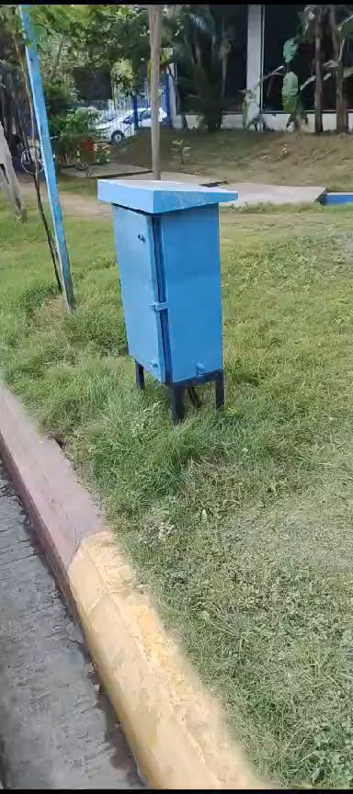
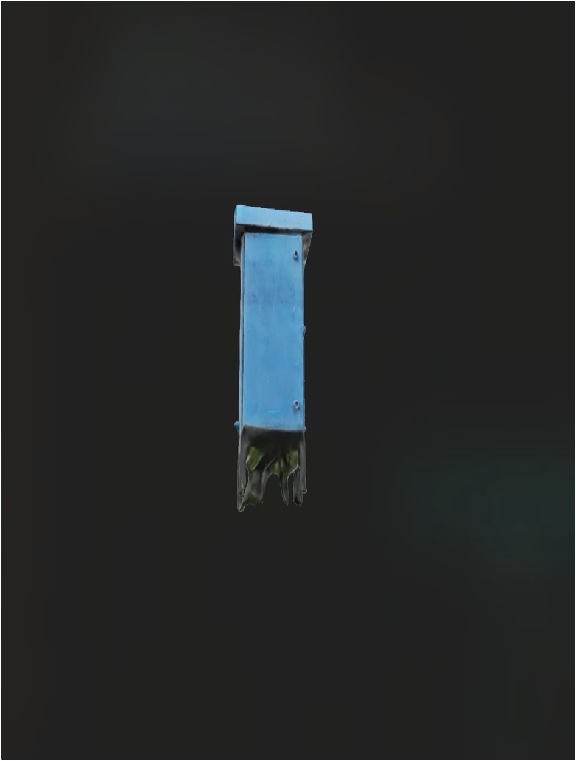
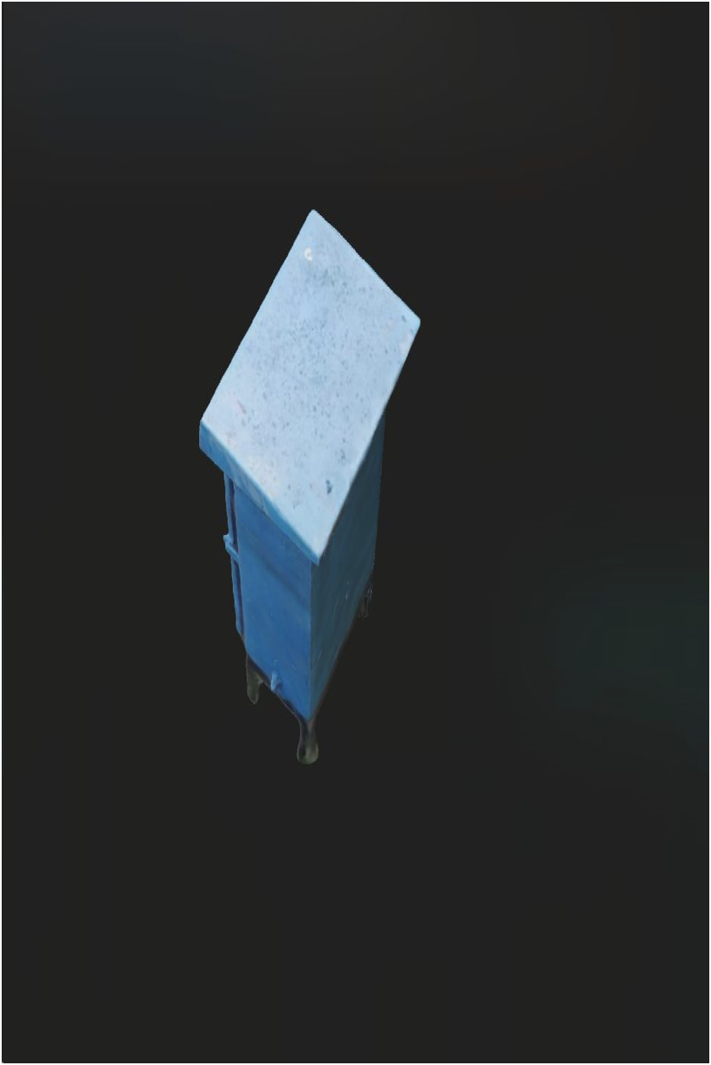
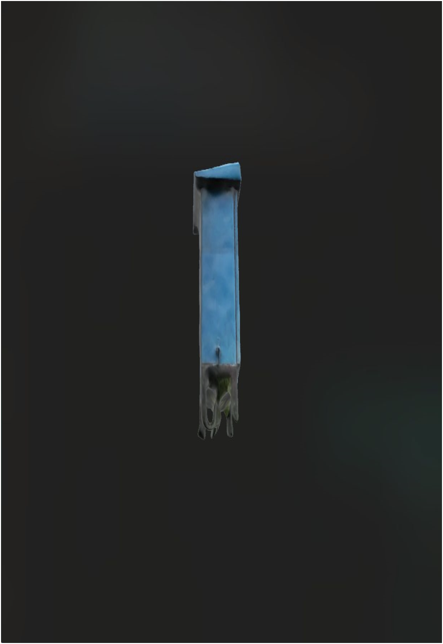
Prototype (MVP)
SKETCH FAB 3-D MODEL SHOWN HERE
Demo of how to film the video
(video should be atleast 1-2 min long)

Slide 11
Go To Market Strategy(GTM)
GTM Strategy Summary:
Target: Rural agencies, gov’t bodies, NGOs, contractors, Beneficiaries under MGNREGA.
Partnerships: Align with gov’t for app endorsement.
Training: Workshops for stakeholder app education.
Marketing: Social media, online ads, SEO.
Word of Mouth: User testimonials for credibility.
Pilots: Test in select areas, refine based on feedback.
Community: Local outreach for awareness and adoption.
Feedback: In-app mechanism for continuous improvement.
Scale: Expand post-pilot success, informed by insights.

Slide 12
Funding Plan
As a team, we've carefully crafted our funding strategy to ensure the successful development and launch of our solution. Here's how we plan to secure the financial resources needed:
Initial Investment: Self-funding for technology, personnel, and infrastructure.
Seed Funding: Secure initial capital from investors and grants.
Series A: Institutional funds for growth post-pilot success.
Govt. Grants: Tap into rural innovation grants.
Partnerships: Co-funding from aligned organizations.
Debt Financing: Loans for working capital with favorable terms.
Revenue : Monetize via subscriptions or purchases.
Projections: Present ROI and conservative financial forecasts.

Slide 13
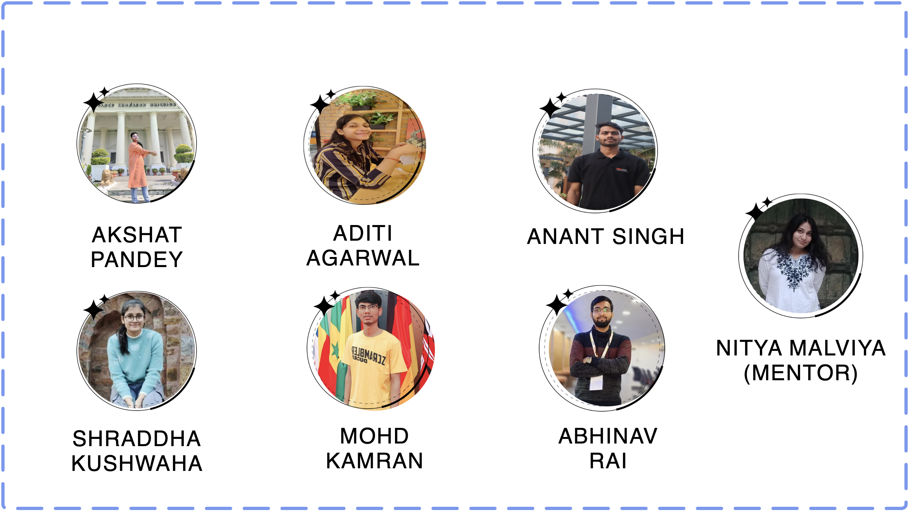
Team Composition

